Slide 1
Time Series Analysis of Crime Rate in Chicago
Al Alipour, PhD
Mentor: Chris Esposo
Capstone 3 Project
Springboard Data Science Career Track

Slide 2

Problem Statement
Crime rate in Chicago is more than US average
Forecasting crime rate for planning and management purposes
Seasonality and trend

Slide 3
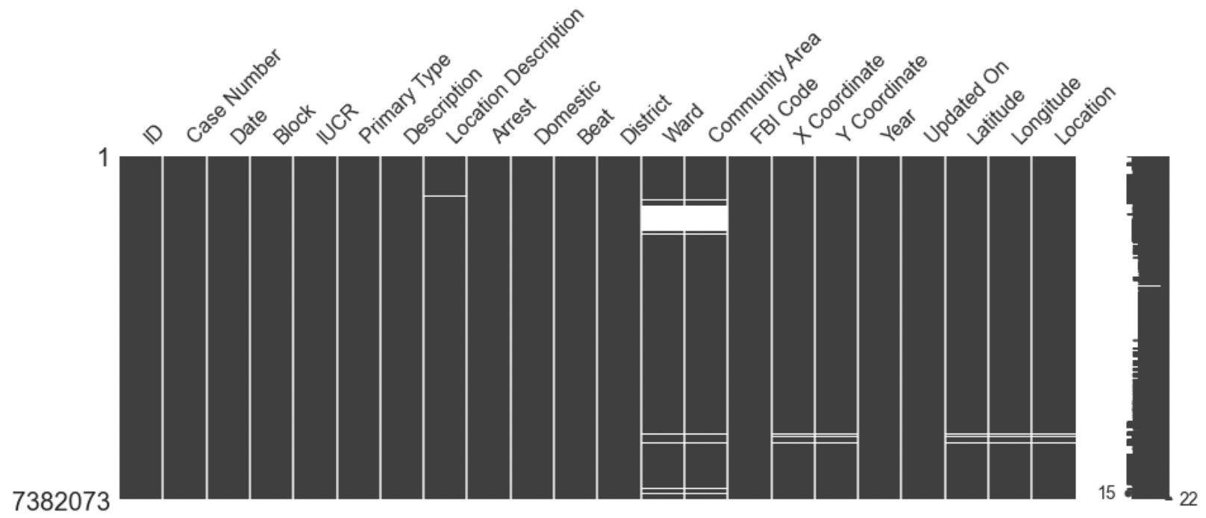
Data and Preparation
City of Chicago’s data portal:
More than 7,000,000 records of criminal activities in the city between January 1, 2001
and August 12, 2021

Slide 4
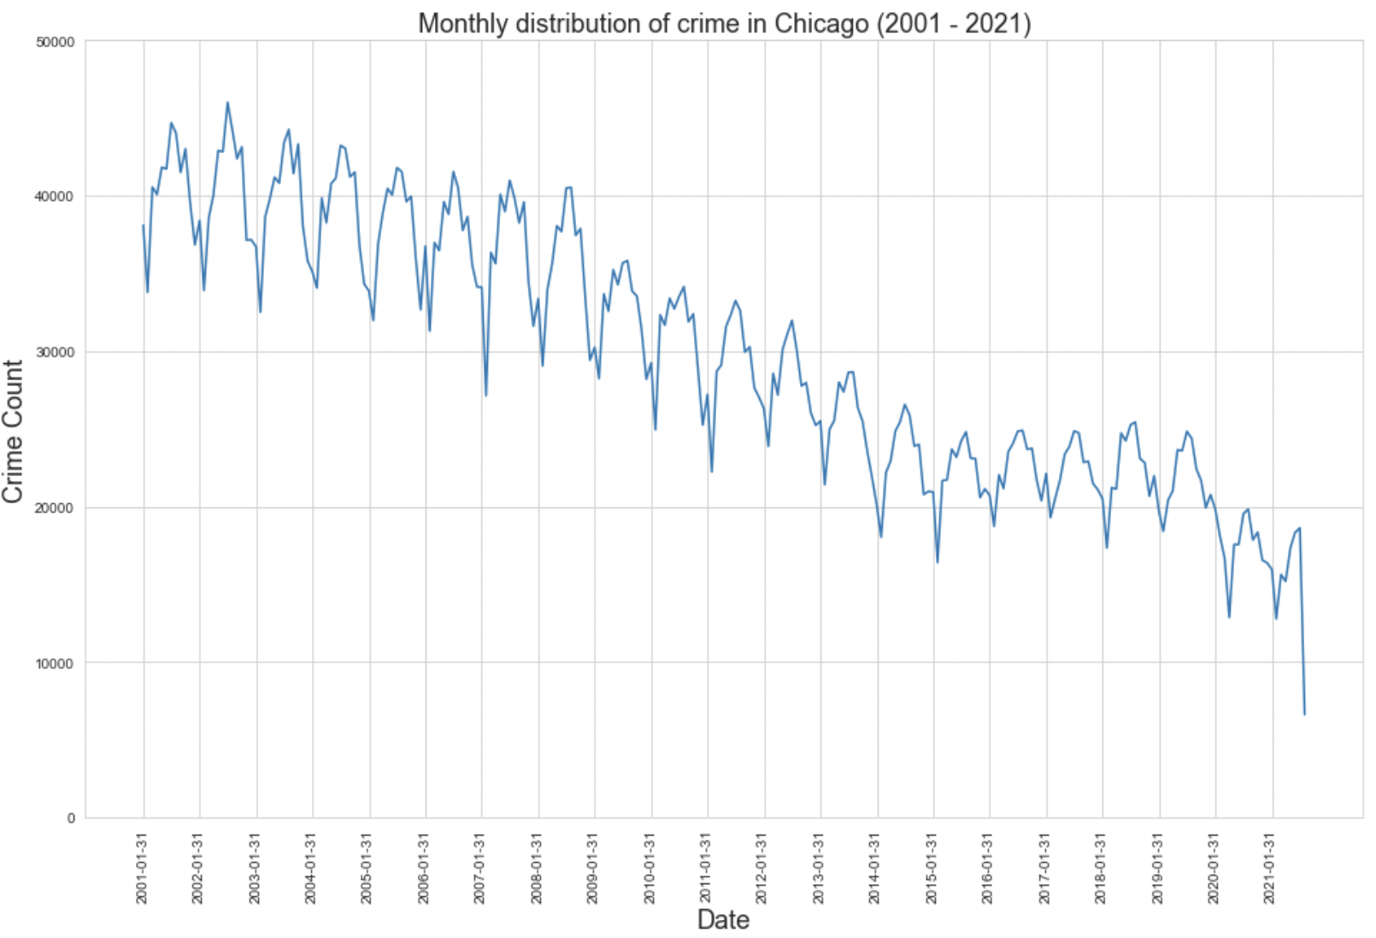
Exploratory Data Analysis
Monthly distribution of crime rate

Slide 5
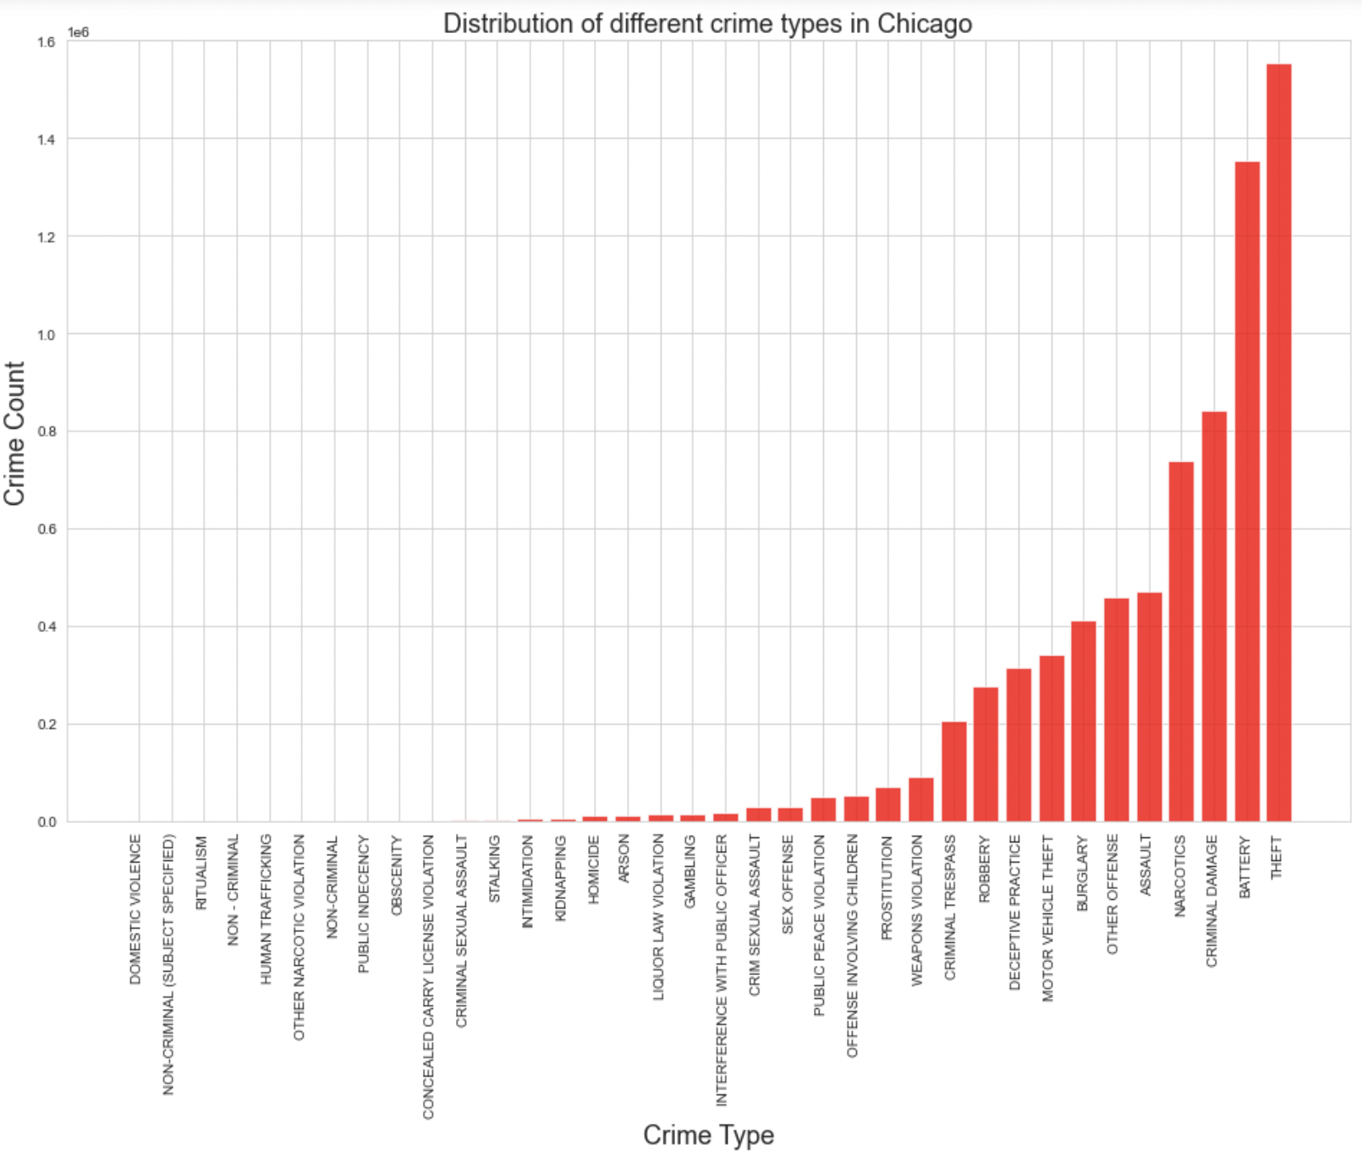
Exploratory Data Analysis
Crime type distribution

Slide 6
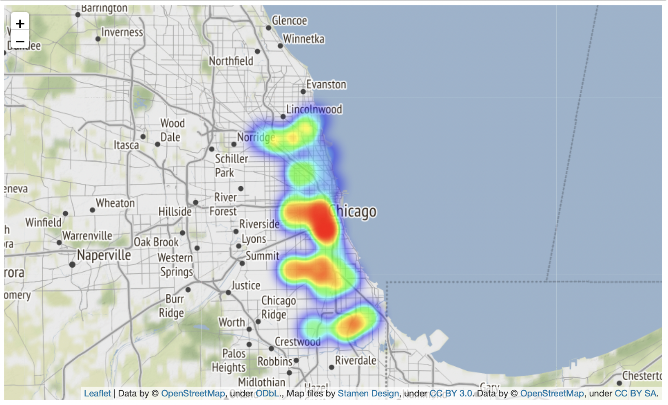
Exploratory Data Analysis
Geographic distribution of crime

Slide 7
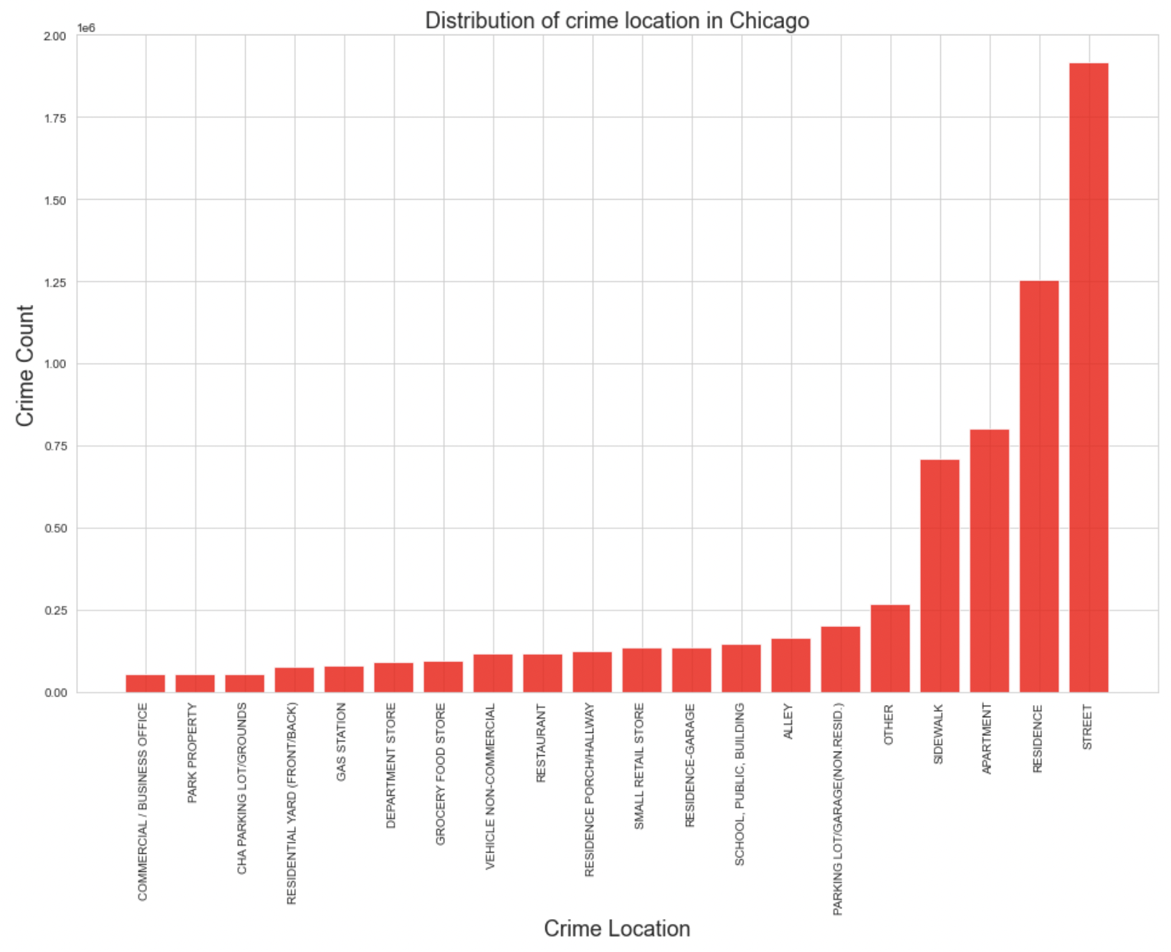
Exploratory Data Analysis
Most frequent locations
for criminal activities

Slide 8
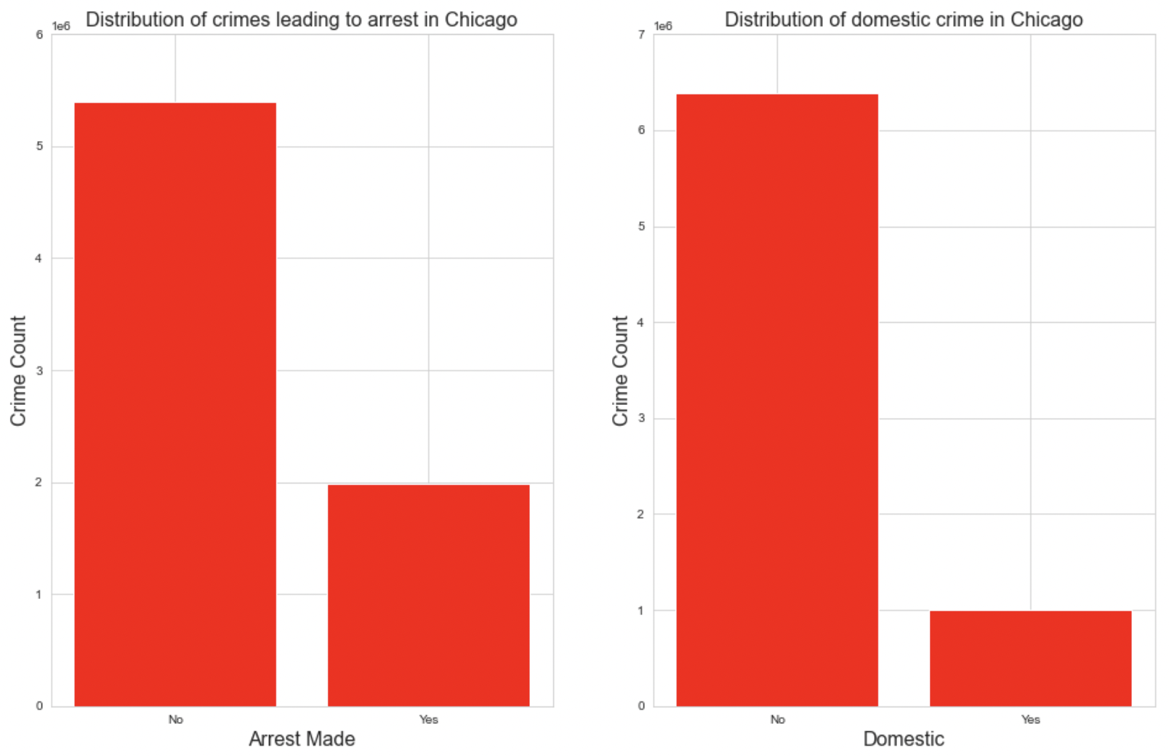
Exploratory Data Analysis
Percentage of arrests made / Domestic criminal activities

Slide 9
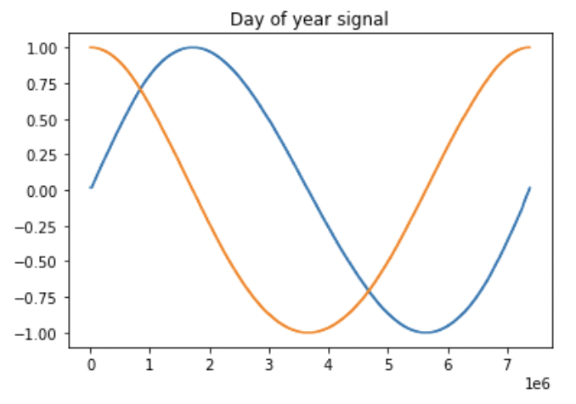
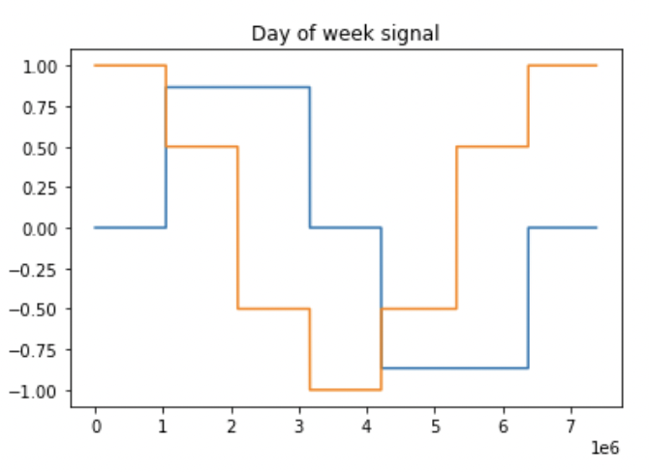
Preprocessing
Feature engineering
Standardization
Train/validation/test split

Slide 10
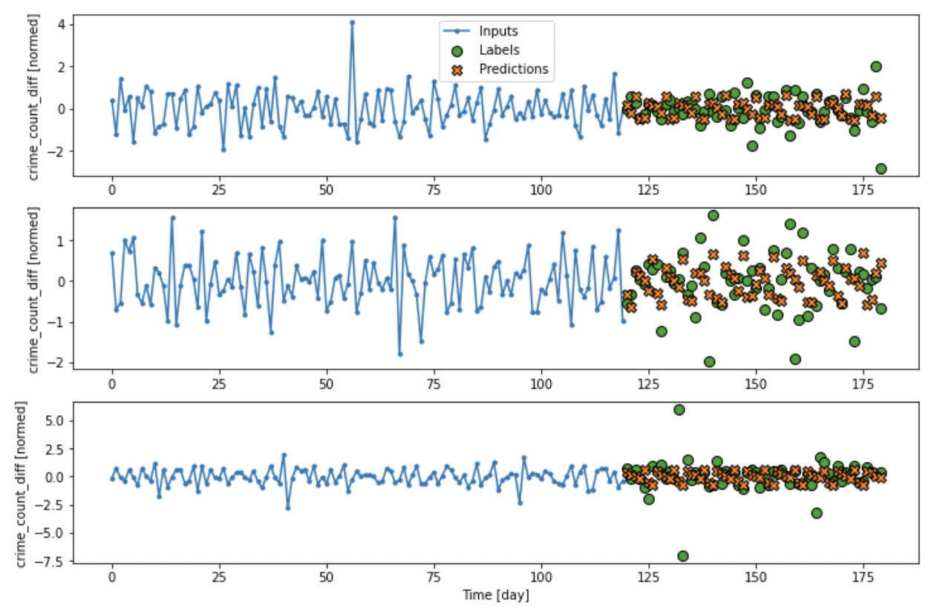
Modelling
LSTM: 32 batches of a window size of 120 for inputs and 60 for labels

Slide 11
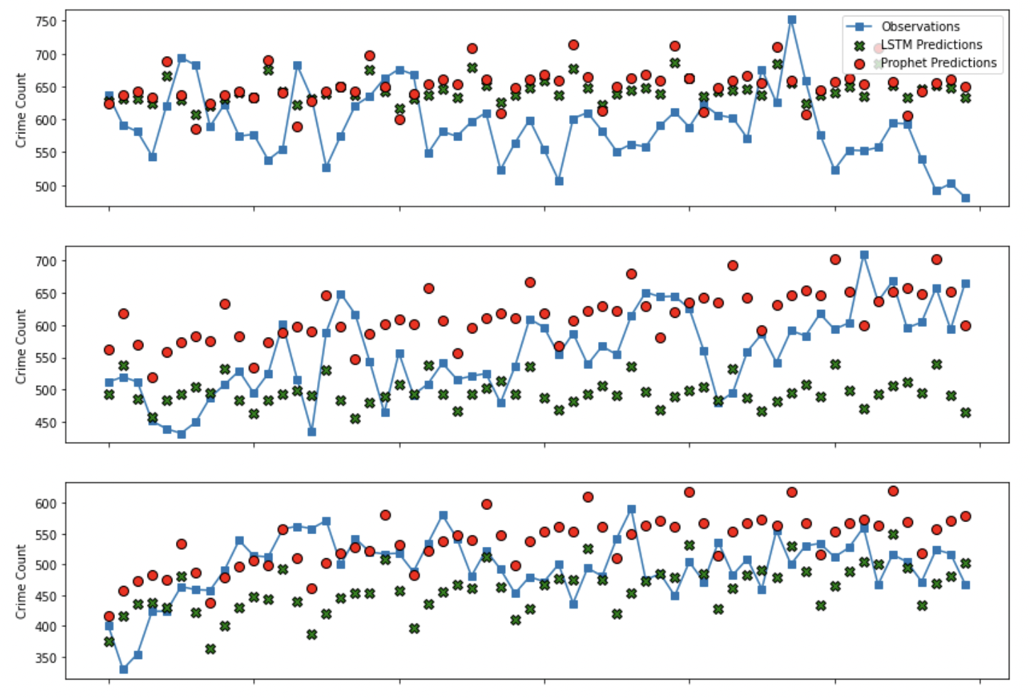
Modelling
LSTM vs Facebook Prophet

Slide 12
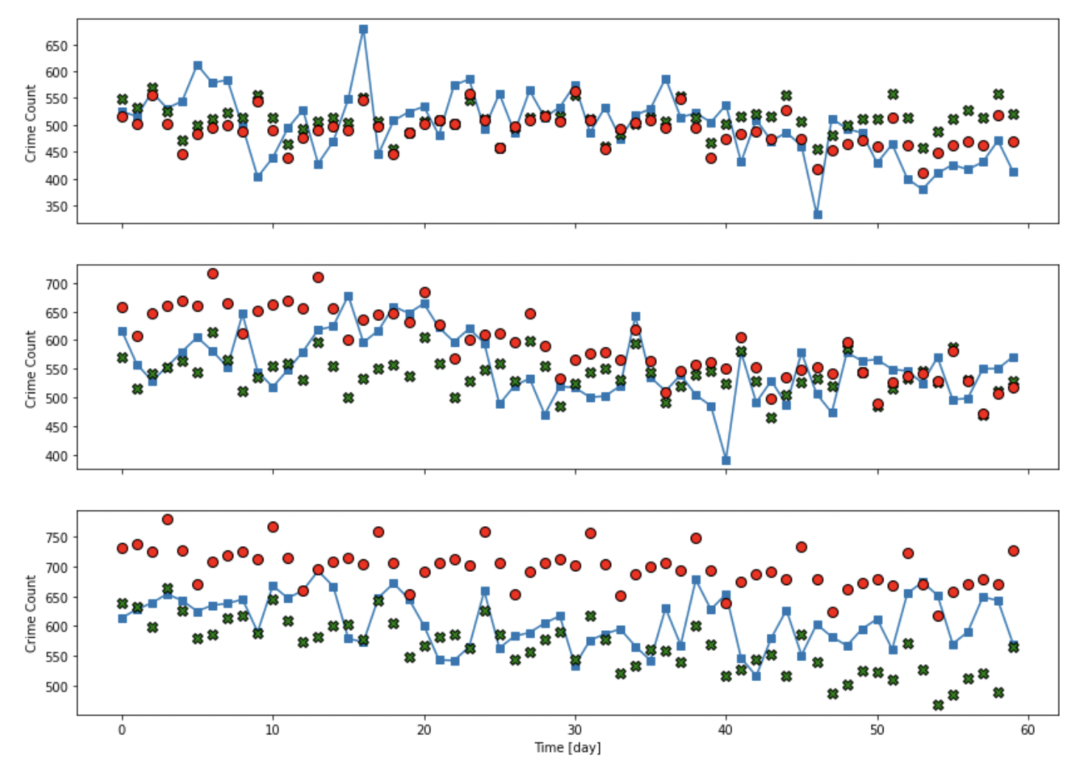
Modelling
LSTM vs Facebook Prophet

Slide 13
Recommendations and Future Research
The selected LSTM model can be used to forecast future crime rates for any length of time. However, given the computational capacity available, the model was fit to data batches of 120 days for inputs and 60 days for labels. Thus, the model has been tested for forecasting future crime rates for 60 day periods.
The selected LSTM model proves more reliable in forecasting future crime rates than Facebook Prophet. The performance of the model probably can even be improved further by applying a more rigorous hyper parameter tuning.
It would be very interesting to perform a more rigorous grid search including trying out varying window sizes and see how the performance of the model improves. It would also be interesting to engineer some other useful features and analyze the model performance. One important addition could be through incorporating location information in the analysis and performing a neighborhood- or district-wise analysis.

